Slide 1
Hashicorp Terraform
Hampton Roads Cloud User Group
6/27/2019

Slide 2
Agenda
What is Terraform?
Where does Terraform run?
When should we use Terraform?
Why do we choose Terraform over other alternatives?
How does it work?

Slide 3
What is Terraform?
Terraform is an open-source infrastructure as code software tool created by HashiCorp. It enables users to define and provision a datacenter infrastructure using a high-level configuration language known as Hashicorp Configuration Language, or optionally JSON. Wikipedia
Terraform is written in the Go language.

Slide 4
Example
resource "azurerm_resource_group" "myterraformgroup" {
name = "myResourceGroup"
location = "eastus"
tags = {
environment = "Terraform Demo"
}
}

Slide 5
Where does Terraform run?
Linux
FreeBSD
macOS
OpenBSD
Solaris
Microsoft Windows
Wikipedia
Terraform supports a number of cloud infrastructure providers such as:
Amazon Web Services
Microsoft Azure
Google Cloud Platform
IBM Cloud (formerly Bluemix)
Linode
Oracle Cloud Infrastructure
VMware vSphere
OpenStack

Slide 6
When should we use Terraform?
Agile Development
DevOps
Infrastructure as Code
Cloud Services (Scalable / Elastic)
Kubernetes / Docker / Containers
Microservices

Slide 7
Why do we choose Terraform over other alternatives?
Chef, Puppet, Ansible, and SaltStack
Configuration Mgmt
designed to install and manage software on existing servers
Terraform and CloudFormation
Orchestration
designed to provision the servers themselves

Slide 8
Why do we choose Terraform over other alternatives?
Chef, Puppet, Ansible, and SaltStack
Mutable Infrastructure
changes will happen in-place
unique history of changes
Configuration Drift
Terraform (Docker / Packer)
Immutable Infrastructure
Build New
Deploy, Test, and Validate
Decommission Old
Easy Scale / Elastic

Slide 9
Why do we choose Terraform over other alternatives?
Chef and Ansible
Procedural
write code that specifies, step-by-step, how to to achieve some desired end state
Terraform, CloudFormation, Puppet, and SaltStack
Declarative
write code that specifies your desired end state, and the tool figures out how to achieve that state

Slide 10
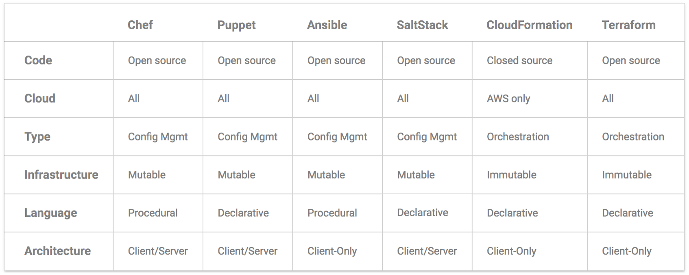
Summary
Notes:
Reference: https://blog.gruntwork.io/why-we-use-terraform-and-not-chef-puppet-ansible-saltstack-or-cloudformation-7989dad2865c

Slide 11
How does it work?
DEMO

Slide 12
Problems / Cons
Operations becomes more like Developers than ever before
Learning to manage code
Breaking silos
Culture problems
Bimodal IT
Us vs them
Notes:
Reference: https://continuousdelivery.com/2016/04/the-flaw-at-the-heart-of-bimodal-it/

Slide 13
Questions?

